Slide 1
Data Analysis Using Alteryx
MIS 634
Business Intelligence & Data Integration - LAB

Slide 2
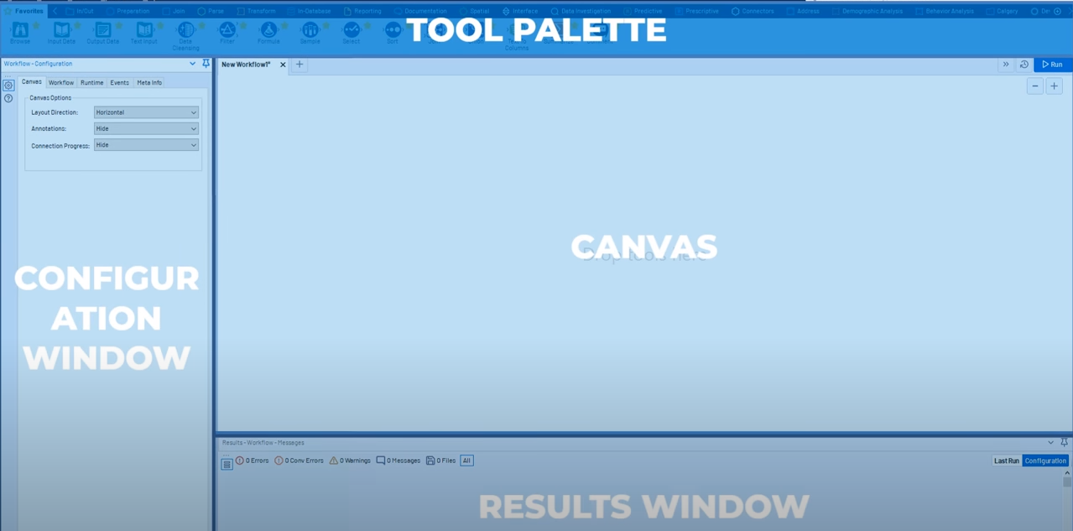
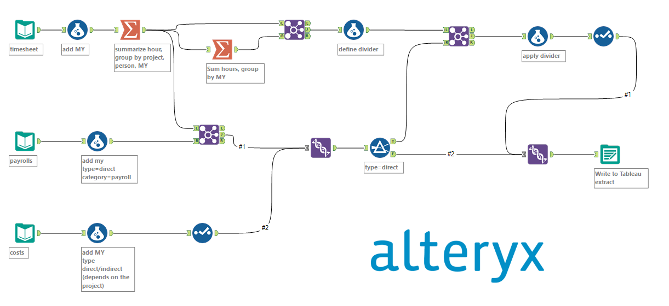
Review:

Slide 3
Key Steps for a Data Analytics Project
An interview question:
What is the process of a data analysis project?

Slide 4
Key Steps for a Data Analytics Project
Problem Statement
Data Collection : Kaggle / BIA660
Data Processing: including data clean
Exploratory Data Analysis (EDA)
Feature Engineering: including feature selection
Modelling: Tuning Model/ Model Comparison and Selection
Communication: Report/ Presentation

Slide 5
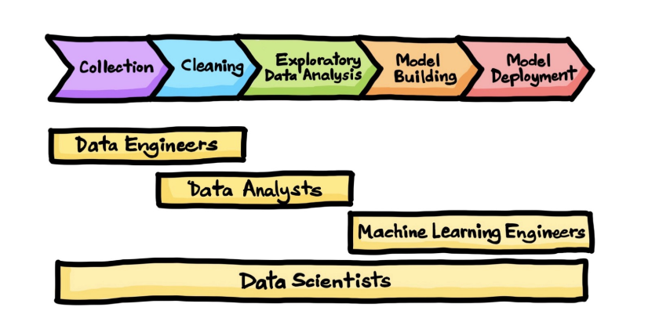

Slide 6
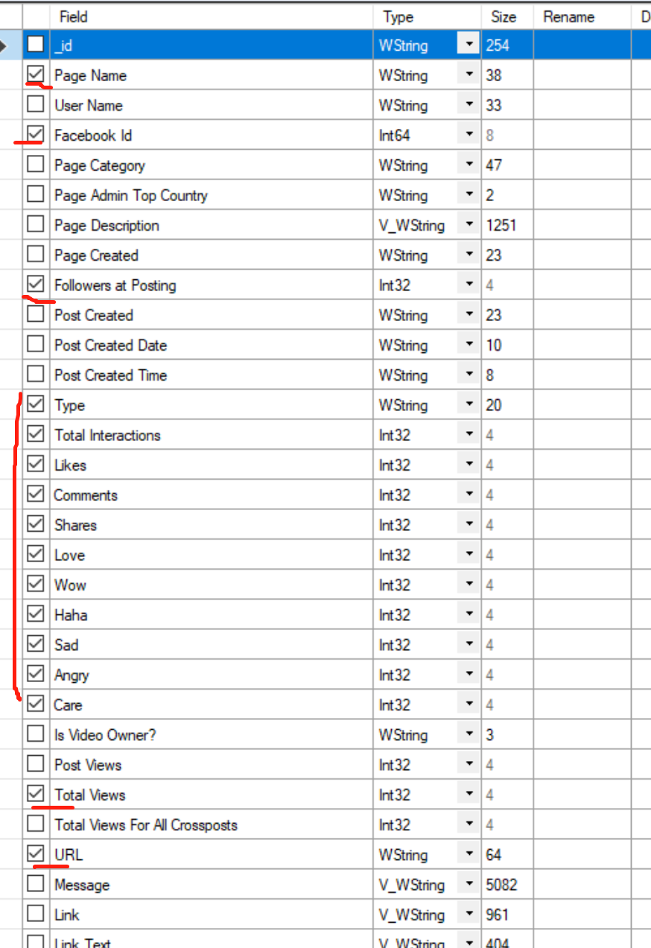
Demo
Dataset: Facebook Posts Dataset
Research Question: 1. What is the relationship between “Like” and “Comment”?
2. What is the sentiment of the posts?
Numerical Features: Followers at Posting, Likes, Comments, Shares, Love, Wow, Haha, Sad, Angry, Care;
Textual Features: Message, Page Name, Facebook ID, URL.

Slide 7
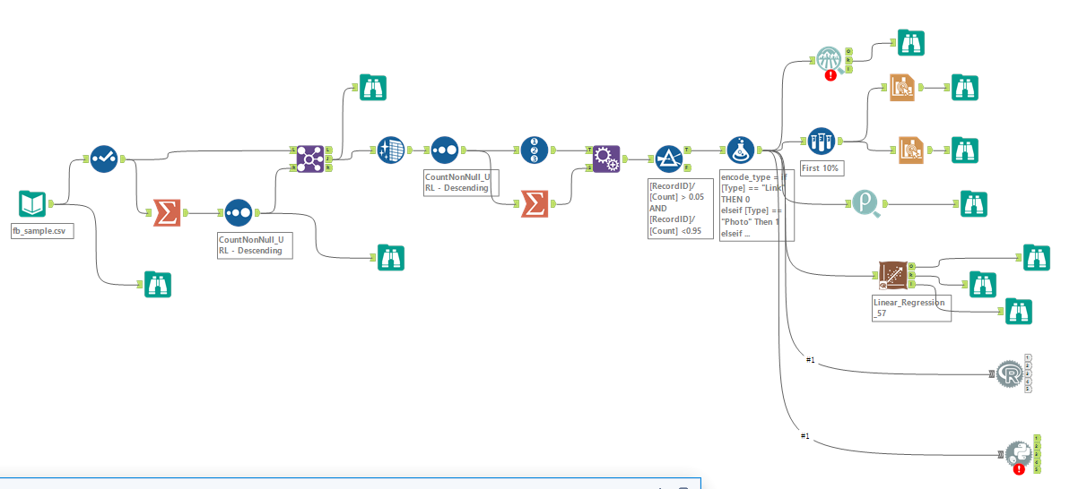


Demo
Label encoding
Count the total posts for each account
Remove the outliers
Not Required

Slide 8
Homework:
Historical-Report-2020-01-01--2021-03-01 contains Facebook posts of some companies. Please use Alteryx to complete the following steps:
Clean data: remove the rows which has null value in column “User Name”
Filter out the posts which are from the accounts whose name contain “boston” ( If the “User Name” contains “boston”, we should filter these posts out)
Use “Select” tool to change the datatype based on your needs
Remove the Facebook Pages which have less than 10 posts (<10)
Group by “User Name” , count how many posts for each Facebook page and answer the question “which three Facebook pages have the most likes? ” ( Answer the question with the “comment” tool) “which three Facebook pages have the most comments? ” ( Answer the question with the “comment” tool)
Do label encoding on “Page Admin Top Country” (classify the country as “US”, “CA” “Others”), and visualize the counts of each category in a bar chart.
Visualize the relationship between “Likes” and “Comments” with scatter plot.
Bonus: Create a new column, called “my_interaction”, and the value of it is the sum of “Likes”, “Comments” and “Shares” Group by year and month of “post_year” and answer the question “Which three months have the most interaction?”
Please submit the screenshot of the whole pipelines and plots, and the .yxmd file.

Slide 9
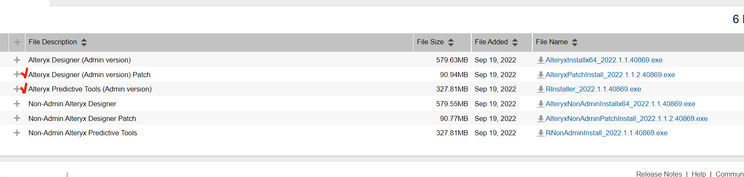
Appendix 1: About Predictive Tool & R Tool
To use the predictive tool and R tool, you need to install “Alteryx Designer Patch” and “Alteryx Predictive Tools”.

Slide 10
Appendix 2: Install R Package
Import the Install R Package app:
https://community.alteryx.com/t5/Public-Community-Gallery/Install-R-Packages/tac-p/908270#M348
Follow this tutorial to install R package:
https://www.youtube.com/watch?v=k4QEX2ONTWY

